Slide 1

Information Management System Lab

Slide 2
About IMS Lab Evaluation
Continuous Lab Evaluation (30)

Slide 3
Data and Information
Data is raw, unorganized facts that need to be processed.
•Data can be something simple, random and useless until it is organized.
–Each student's exam marks
•When data is processed, organized, structured or presented in a given context to make it useful, it is called information.
–The average score of a department or of the entire college is information that is derived from the given data.

Slide 4

Information Management System
An Information Management System consists of
A collection of interrelated and persistent data (usually referred as database).
A set of application programs used to access, update and manage that data (usually referred as management system).

Slide 5
Query Language
SQL (structured query language) is a computer language aimed to store, manipulate, and retrieve data stored in relational databases.
MySQL is one of the most popular open source SQL database management system.
It is developed, distributed and supported by Oracle corporation.
Supports including Windows, Linux, UNIX, Mac…

Slide 6
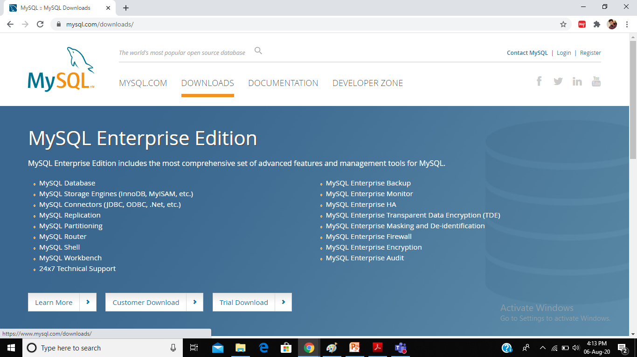
Install MySQL
Scroll down this page

Slide 7
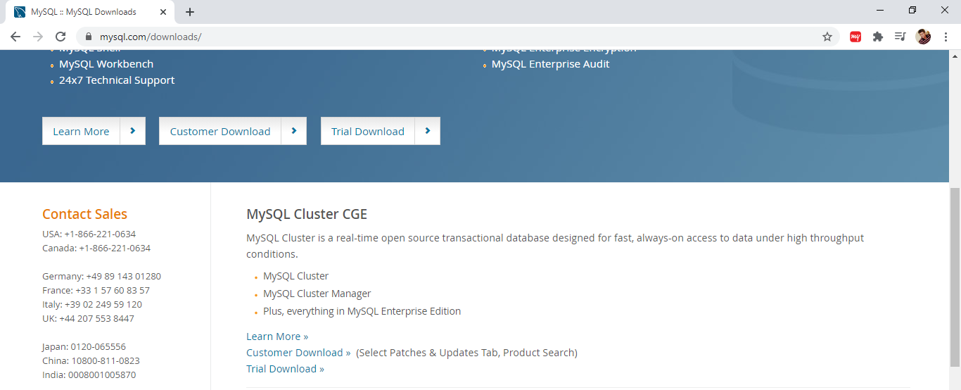
Install MySQL
Click on MySQL Community downloads

Slide 8
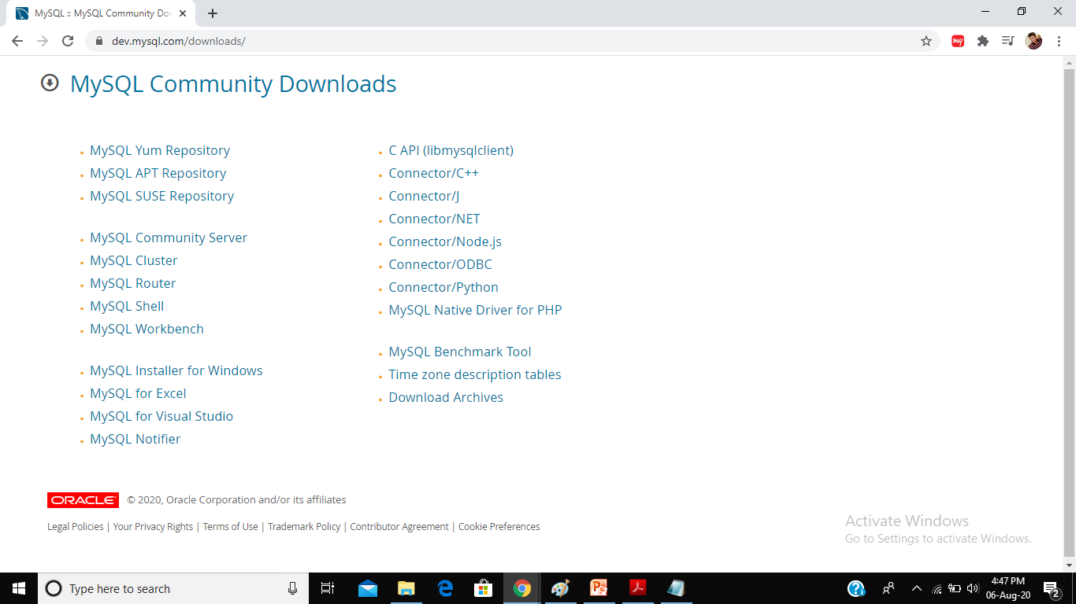
Install MySQL
Click on the option according to your environment

Slide 9
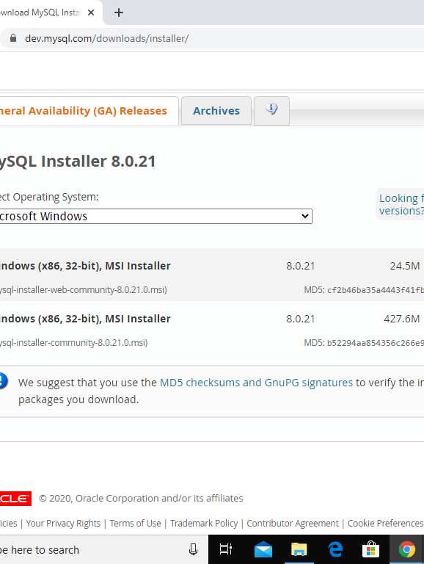
Install MySQL
For windows, download from the 1st option

Slide 10
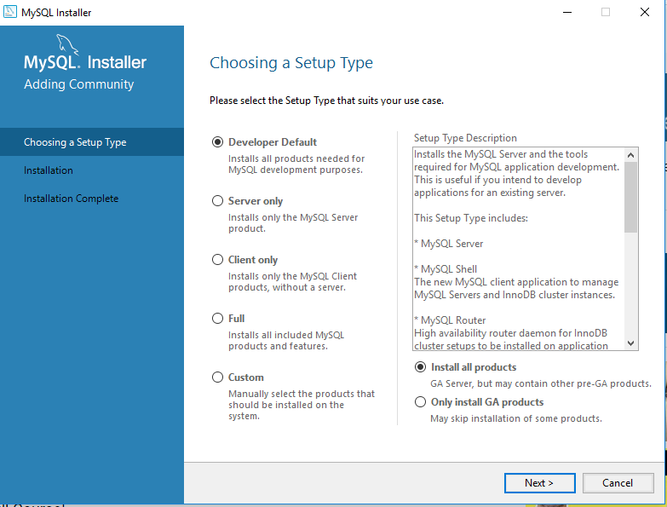
MySQL Installer
Choose Developer and click next and continue the process

Slide 11
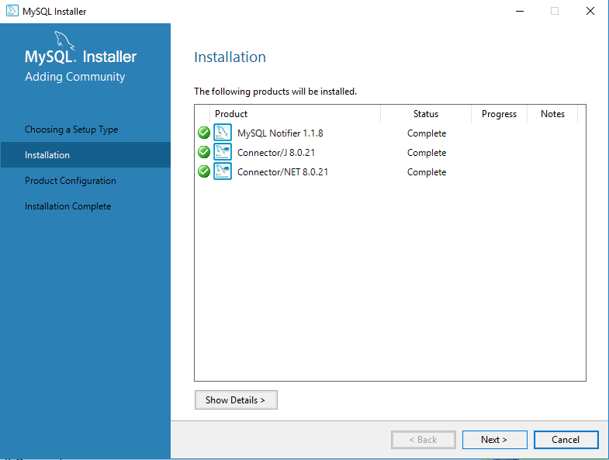
MySQL Installer
click next and continue the process

Slide 12

SQL categorization
SQL commands are mainly categorized into four categories as:
DDL – Data Definition Language
DML – Data Manipulation Language
DQL – Data Query Language
DCL – Data Control Language

Slide 13

DDL
DDL(Data Definition Language) : Data Definition Language consists of the SQL commands that can be used to define the database schema.
It simply deals with descriptions of the database schema and is used to create and modify the structure of database objects in the database.
Some examples of DDL commands:
CREATE – is used to create the database or its objects (like table, index, function, views, store procedure and triggers).
DROP – is used to delete objects from the database.
ALTER-is used to alter the structure of the database.
TRUNCATE–is used to remove all records from a table, including all spaces allocated for the records are removed.
COMMENT –is used to add comments to the data dictionary.
RENAME –is used to rename an object existing in the database.

Slide 14
DML
DML(Data Manipulation Language) : The SQL commands that deals with the manipulation of data present in the database belong to Data Manipulation Language.
Examples of DML:
INSERT– is used to insert data into a table.
UPDATE– is used to update existing data within a table.
DELETE – is used to delete records from a database table.

Slide 15
DQL
DQL (Data Query Language) :
The purpose of DQL Command is to get some schema relation based on the query.
Example of DQL:
SELECT– is used to retrieve data from the a database.

Slide 16
DCL
DCL(Data Control Language) : DCL includes commands such as GRANT and REVOKE which mainly deals with the rights, permissions and other controls of the database system.
Examples of DCL commands:
GRANT-gives user’s access privileges to database.
REVOKE-withdraw user’s access privileges given by using the GRANT command.

Slide 17
TCL
TCL(transaction Control Language) : TCL commands deals with the transaction within the database.
Examples of TCL commands:
COMMIT– commits a Transaction.
ROLLBACK– rollbacks a transaction in case of any error occurs.
SAVEPOINT–sets a savepoint within a transaction.
SET TRANSACTION–specify characteristics for the transaction.

Slide 18
Create Database
The CREATE DATABASE statement is used to create a new SQL database.
Syntax
CREATE DATABASE databasename;
Example:
CREATE DATABASE testDB;
To check whether the database is present, use following SQL command
SHOW DATABASES;

Slide 19

Drop Database
The DROP DATABASE statement is used to drop an existing SQL database.
Syntax
DROP DATABASE databasename;
Note: Deleting a database will result in loss of complete information stored in the database!
Example
DROP DATABASE testDB;
Tip: You can check it in the list of databases with the following SQL command: SHOW DATABASES;

Slide 20

Use Database
To use the database, we need to write following SQL command:
Syntax
USE databasename;
Example
USE testDB;

Slide 21
Creating Table
The CREATE TABLE statement is used to create a new table in a database.
Syntax
CREATE TABLE table_name ( column1 datatype, column2 datatype, column3 datatype, .... );
The column parameters specify the names of the columns of the table.
The datatype parameter specifies the type of data the column can hold (e.g. varchar, integer, date, etc.).

Slide 22

Create Table example
SQL CREATE TABLE Example
The following example creates a table called "Persons" that contains five columns: PersonID, LastName, FirstName, Address, and City:
Example
CREATE TABLE Persons ( PersonID int, LastName varchar(255), FirstName varchar(255), Address varchar(255), City varchar(255) );

Slide 23
Popular Data Types
Data Type Syntax | Explanation
CHAR(size) | Maximum size of 255 characters. size is the number of characters to store.
VARCHAR(size) | Maximum size of 255 characters. Variable-length string.
TEXT(size) | Maximum size of 65,535 characters. Where size is the number of characters to store.
BINARY(size) | Maximum size of 255 characters. Where size is the number of binary characters to store. Fixed-length strings.
INT(m) | Standard integer value. Signed values range from -2147483648 to 2147483647. Unsigned values range from 0 to 4294967295.
FLOAT(m,d) | Single precision floating point number. Where m is the total digits and d is the number of digits after the decimal.
DOUBLE(m,d) | Double precision floating point number. Where m is the total digits and d is the number of digits after the decimal.
DATE | Values range from '1000-01-01' to '9999-12-31'. Displayed as 'YYYY-MM-DD'.
DATETIME | Values range from '1000-01-01 00:00:00' to '9999-12-31 23:59:59'. Displayed as 'YYYY-MM-DD HH:MM:SS'.

Slide 24
Drop Table
The DROP TABLE statement is used to drop an existing table in a database.
Syntax
DROP TABLE table_name;
Note: Deleting a table will result in loss of complete information stored in the table!
Example:
DROP TABLE team;

Slide 25

Truncate Table
The TRUNCATE TABLE statement is used to delete the data inside a table, but not the table itself.
Syntax
TRUNCATE TABLE table_name;
Example
TRUNCATE TABLE team;

Slide 26

Alter Table
The ALTER TABLE statement is used to add, delete, or modify columns in an existing table.
The ALTER TABLE statement is also used to add and drop various constraints on an existing table.

Slide 27

ALTER Table - ADD Column
To add a column in a table, use the following syntax:
ALTER TABLE table_name ADD column_name datatype;
The following SQL adds an "Email" column to the “Persons" table:
Example
ALTER TABLE Persons ADD Email varchar(255);

Slide 28
ALTER Table - DROP Column
To delete a column in a table, use the following syntax (notice that some database systems don't allow deleting a column):
ALTER TABLE table_name DROP COLUMN column_name;
The following SQL deletes the "Email" column from the “Persons" table:
Example
ALTER TABLE Persons DROP COLUMN Email;

Slide 29
ALTER Table - ALTER/MODIFY Column
To change the data type of a column in a table, use the following syntax:
ALTER TABLE table_name MODIFY COLUMN column_name datatype;
Example
ALTER TABLE Persons ADD DateOfBirth date;
ALTER TABLE Persons MODIFY COLUMN DateOfBirth year;

Slide 30

RENAME Table
RENAME TABLE renames one or more tables. You must have ALTER and DROP privileges for the original table, and CREATE and INSERT privileges for the new table.
Syntax:
RENAME TABLE tbname TO new_tbname [, tbname2 TO new_tbname2] … ;
Example:
To rename a table named Persons to Employee, use this statement:
RENAME TABLE Persons TO Employee;
We can also use
ALTER TABLE Persons RENAME Employee;

Slide 31

RENAME Contd.
RENAME TABLE, unlike ALTER TABLE, can rename multiple tables within a single statement:
RENAME TABLE old_table1 TO new_table1,
old_table2 TO new_table2,
old_table3 TO new_table3;
Renaming operations are performed left to right. Thus, to swap two table names, do this (assuming that a table with the intermediary name tmp_table does not already exist):
RENAME TABLE old_table TO tmp_table,
new_table TO old_table,
tmp_table TO new_table;

Slide 32
Add Comment
Add comment corresponding to a column
ALTER TABLE Example
MODIFY COLUMN `id` int(10) COMMENT 'Look, I am a comment!’;

Slide 33

SELECT Command
The SELECT statement is used to select data from a database.
The data returned is stored in a result table, called the result-set.
Syntax
SELECT column1, column2, ... FROM table_name;
Here, column1, column2, ... are the field names of the table you want to select data from. If you want to select all the fields available in the table, use the following syntax:
SELECT * FROM table_name

Slide 34

SELECT DISTINCT Command
The SELECT DISTINCT statement is used to return only distinct (different) values.
Inside a table, a column often contains many duplicate values; and sometimes you only want to list the different (distinct) values.
Syntax
SELECT DISTINCT column1, column2, ... FROM table_name;
Example
SELECT DISTINCT City FROM Persons;

Slide 35

WHERE Clause
The WHERE clause is used to filter records.
The WHERE clause is used to extract only those records that fulfill a specified condition.
Syntax
SELECT column1, column2, ... FROM table_name WHERE condition;
Example
SELECT * FROM Persons WHERE City=‘Delhi’;

Slide 36

MySQL Constraints
NOT NULL: By default, a column can hold NULL values. The NOT NULL constraint enforces a column to NOT accept NULL values.
Eg. Select position, pname, role from team where shirt_no is NOT NULL.
UNIQUE: Ensures that all the values in columns are unique. (Eg. Roll no, Date of Birth, tshirt no of same team players etc.)
PRIMARY KEY: Combination of NOT NULL and UNIQUE.
FOREIGN KEY: Uniquely identify a row/record in any other database table.
CHECK: The check constraints ensures that all values in a column specify certain condition.

Slide 37

Example: Create Table
create table team(
position varchar(10),
pname varchar(30),
role varchar(20));

Slide 38
Insert into Table
insert into team
values ('P1','V. Kohli','Bat'),
('P2','R. Sharma','Bat' ),
('P3','M.Dhoni','Wicket'),
('P4','J.Bumrah','Ball'),
('P5','K.Yadav','Ball');

Slide 39
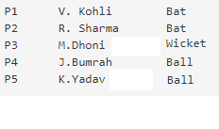
How to display
SELECT position, pname from team;
select * from team;

Slide 40
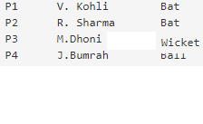
Delete a Member
delete from team
where position='P5';
select * from team;
Delete from team; //all the records will be deleted

Slide 41
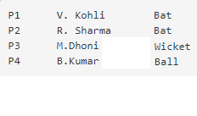
Update
update team
set pname='B.Kumar' where position='P4';
select * from team;

Slide 42
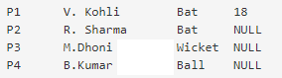
Alter Table
Alter table team
add (shirt_no INT);
update team
set shirt_no=18 where position='P1';
select * from team;

Slide 43
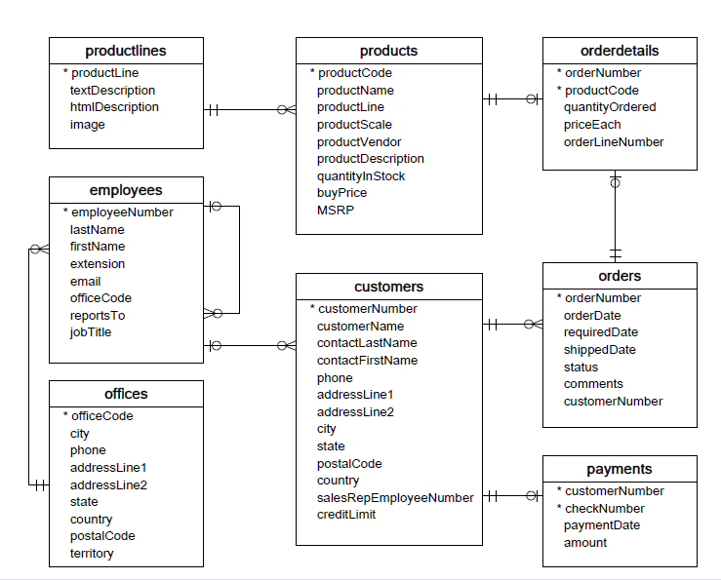
Use Case 1 (Shopping Record)

Slide 44
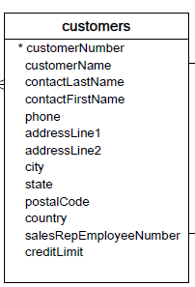
Customers Table
CREATE TABLE customers (
customerNumber varchar(11) NOT NULL,
customerName varchar(50) NOT NULL,
contactLastName varchar(50) NOT NULL,
contactFirstName varchar(50) NOT NULL,
phone varchar(50) NOT NULL,
addressLine1 varchar(50) NOT NULL,
addressLine2 varchar(50) DEFAULT NULL,
city varchar(50) NOT NULL,
state varchar(50) DEFAULT NULL,
postalCode varchar(15) DEFAULT NULL,
country varchar(50) NOT NULL,
salesRepEmployeeNumber int(11) DEFAULT NULL,
creditLimit decimal(10,2) DEFAULT NULL,
PRIMARY KEY (customerNumber)) ;

Slide 45
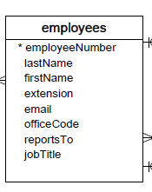
Employees Table
CREATE TABLE employees (
employeeNumber int(11) NOT NULL,
lastName varchar(50) NOT NULL,
firstName varchar(50) NOT NULL,
extension varchar(10) NOT NULL,
email varchar(100) NOT NULL,
officeCode varchar(10) NOT NULL,
reportsTo int(11) DEFAULT NULL,
jobTitle varchar(50) NOT NULL,
PRIMARY KEY (employeeNumber));

Slide 46
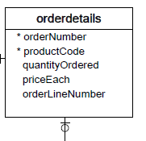
Order Details Table
CREATE TABLE orderdetails (
orderNumber int(11) NOT NULL,
productCode varchar(15) NOT NULL,
quantityOrdered int(11) NOT NULL,
priceEach decimal(10,2) NOT NULL,
orderLineNumber smallint(6) NOT NULL,
PRIMARY KEY (orderNumber,productCode)) ;
Other tables can be created in the similar process.

Slide 47
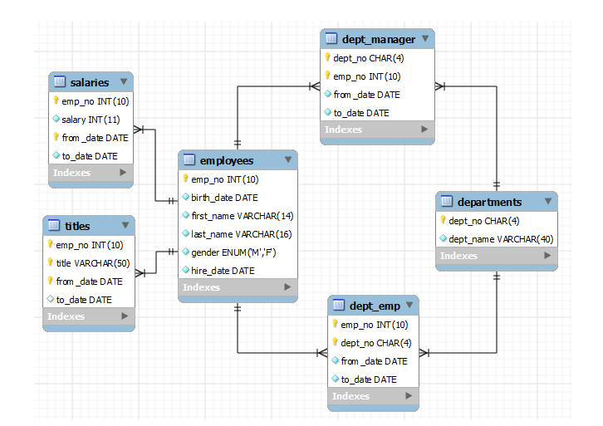
Use Case 2: Office Record

Slide 48
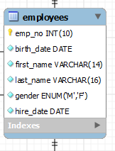
Employee Table
CREATE TABLE employees (
emp_no INT NOT NULL,
birth_date DATE NOT NULL,
first_name VARCHAR(14) NOT NULL,
last_name VARCHAR(16) NOT NULL,
gender ENUM ('M','F') NOT NULL,
hire_date DATE NOT NULL,
PRIMARY KEY (emp_no)
);

Slide 49
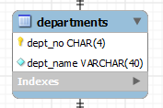
Department Table
CREATE TABLE departments (
dept_no CHAR(4) NOT NULL,
dept_name VARCHAR(40) NOT NULL,
PRIMARY KEY (dept_no),
UNIQUE KEY (dept_name)
);
Other tables can be created in the similar process.

Slide 50
Assignment
Create following two tables:
Find out the Branch_name where amount >=2000.
Find out the name of the customer whose loan_number is L-170.
Delete the customer whose loan_number is 155.
Add gender column in the second table.
Branch_name | Loan_number | amount
Downtown | L-170 | 3000
Redwood | L-230 | 4000
Perryridge | L-260 | 1700
Customer_name | Loan_number
Jones | L-170
Smith | L-230
Hayes | L-155

Slide 51

THANKYOU

